Slide 1

CSCE883 Machine Learning
Lecture 4 Maximum Likelihood Estimation and more
Jianjun Hu
Department of Computer Science & Engineering
University of South Carolina

Slide 2

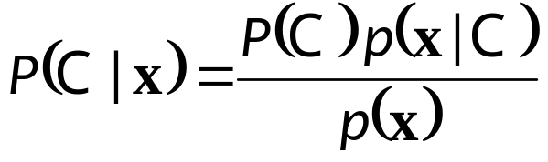
The estimation problem
Estimating the probability of a coin: head or tails…. To check if coin is modified
2
3
5
0.3
0.6
0.1

Slide 3
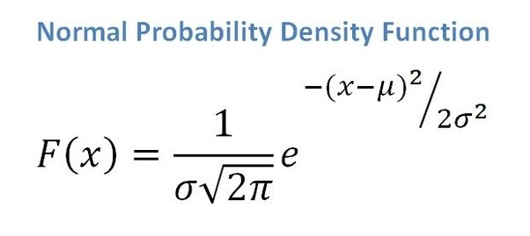
Parametric Estimation
X = { x^{t} }_{t} where x^{t} ~ p (x)
Parametric estimation:
  Assume a form for p (x |θ ) and estimate θ , its sufficient statistics, using X
  e.g., N ( μ, σ²) where θ = { μ, σ²}

Slide 4
Maximum Likelihood Estimation
Likelihood of θ given the sample X
l (θ|X) = p (X |θ) = ∏_{t} p (x^{t}|θ)
Log likelihood
L(θ|X) = log l (θ|X) = ∑_{t} log p (x^{t}|θ)
Maximum likelihood estimator (MLE)
θ* = argmax_{θ} L(θ|X)

Slide 5
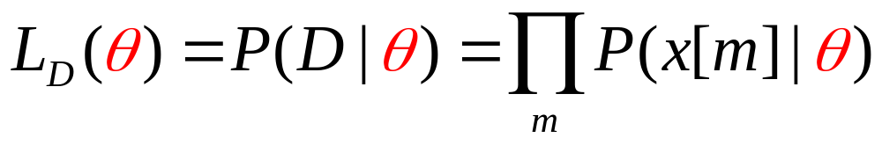
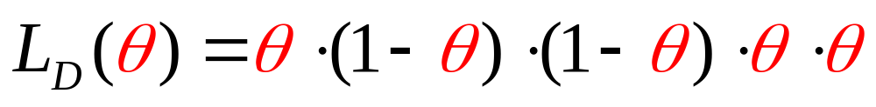
The Likelihood Function
How good is a particular θ?
It depends on how likely it is to generate the observed data
The likelihood for the sequence H,T, T, H, H is
L(θ)
0
0.2
0.4
θ
0.6
0.8
1

Slide 6
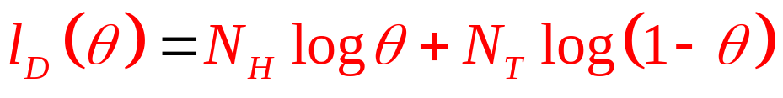
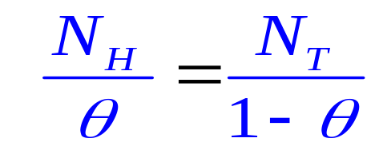
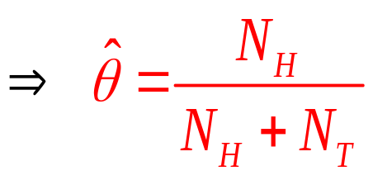
Example: MLE in Binomial Data
Taking derivative and equating it to 0,
we get
(which coincides with what one would expect)
Example:
(N_{H},N_{T} ) = (3,2)
MLE estimate is 3/5 = 0.6
L(θ)
0
0.2
0.4
0.6
0.8
1

Slide 7
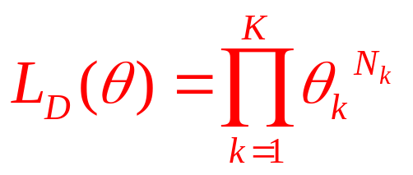
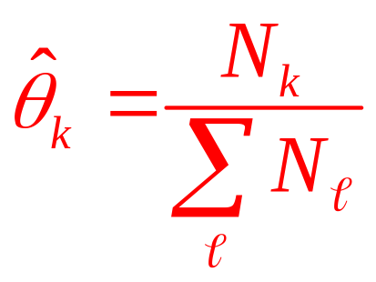
From Binomial to Multinomial
Now suppose X can have the values 1,2,…,K (For example a die has K=6 sides)
We want to learn the parameters θ₁, θ₂. …, θ_{K}
Sufficient statistics:
N₁, N₂, …, N_{K} - the number of times each outcome is observed
Likelihood function:
MLE: (proof @ assignment)
Notes:
A case of a die where 1….6 are the possible values

Slide 8
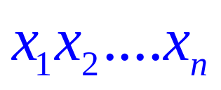
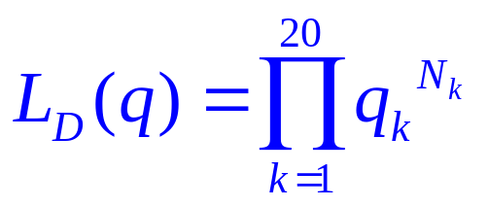
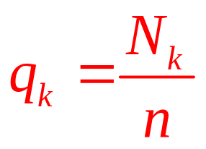
Example: Multinomial
Let be a protein sequence
We want to learn the parameters q₁, q₂,…,q₂₀
corresponding to the frequencies of the 20 amino acids
N₁, N₂, …, N₂₀ - the number of times each amino acid is observed in the sequence
Likelihood function:
MLE:
Notes:
A case of a die where 1….6 are the possible values

Slide 9
Examples: Bernoulli/Multinomial
Bernoulli: Two states, failure/success, x in {0,1}
  P (x) = p_{o}^{x} (1 – p_{o} ) ^{(1 – x)}
  L (p_{o}|X) = log ∏_{t} p_{o}^{xt} (1 – p_{o} ) ^{(1 – xt)}
  MLE: p_{o} = ∑_{t} x^{t} / N
Multinomial: K>2 states, x_{i} in {0,1}
  P (x₁,x₂,...,x_{K}) = ∏_{i} p_{i}^{xi}
  L(p₁,p₂,...,p_{K}|X) = log ∏_{t} ∏_{i} p_{i}^{xit}
  MLE: p_{i} = ∑_{t} x_{i}^{t} / N

Slide 10
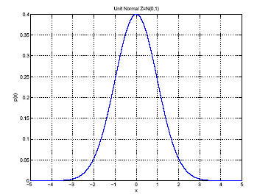
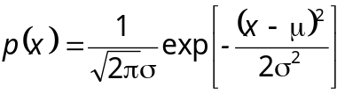
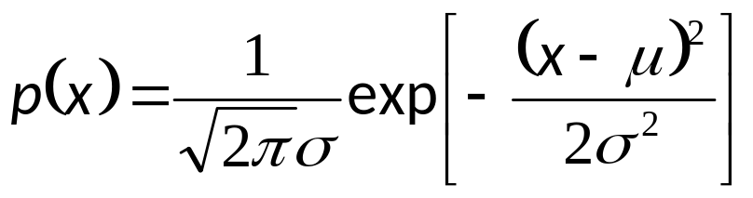
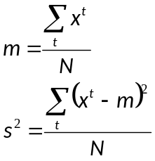
Gaussian (Normal) Distribution
p(x) = N ( μ, σ²)
MLE for μ and σ²:
μ
σ

Slide 11
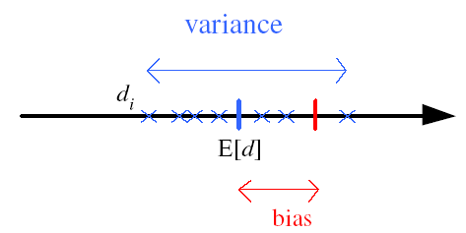
Bias and Variance
Unknown parameter θ
Estimator d_{i} = d (X_{i}) on sample set X_{i}
Bias: b_{θ}(d) = E [d] – θ
Variance: E [(d–E [d])²]
Mean square error:
r (d,θ) = E [(d–θ)²]
= (E [d] – θ)² + E [(d–E [d])²]
= Bias² + Variance
θ

Slide 12
Bayes’ Estimator
Treat θ as a random var with prior p (θ)
Bayes’ rule: p (θ|X) = p(X|θ) p(θ) / p(X)
Full: p(x|X) = ∫ p(x|θ) p(θ|X) dθ
Maximum a Posteriori (MAP):
θ_{MAP} = argmax_{θ} p(θ|X)
Maximum Likelihood (ML): θ_{ML} = argmax_{θ} p(X|θ)
Bayes’: θ_{Bayes’} = E[θ|X] = ∫ θ p(θ|X) dθ

Slide 13
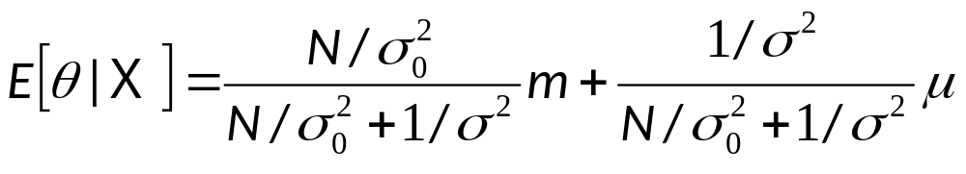
Bayes’ Estimator: Example
x^{t} ~ N (θ, σ_{o}²) and θ ~ N ( μ, σ²)
θ_{ML} = m
θ_{MAP} = θ_{Bayes’} =

Slide 14
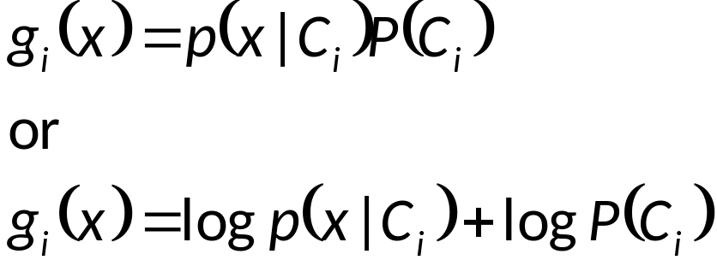
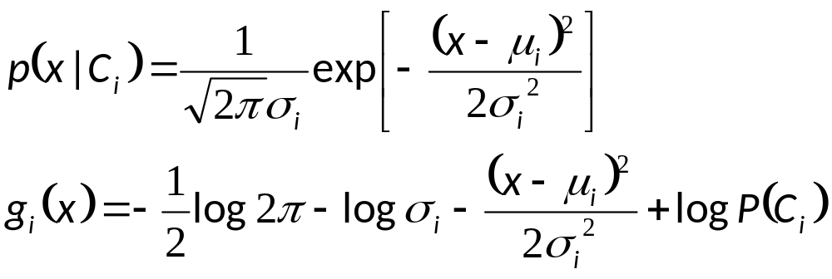
Parametric Classification

Slide 15
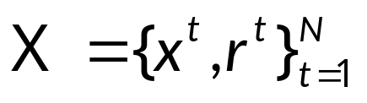
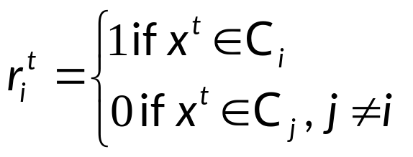

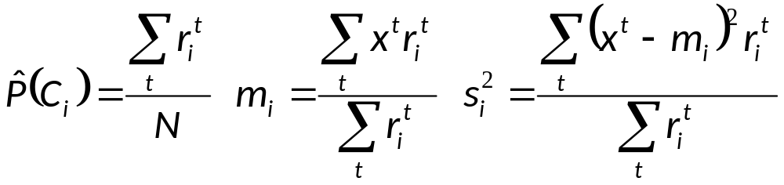
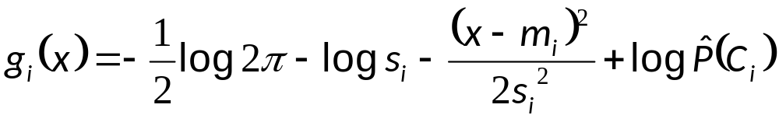
Given the sample
ML estimates are
Discriminant

Slide 16
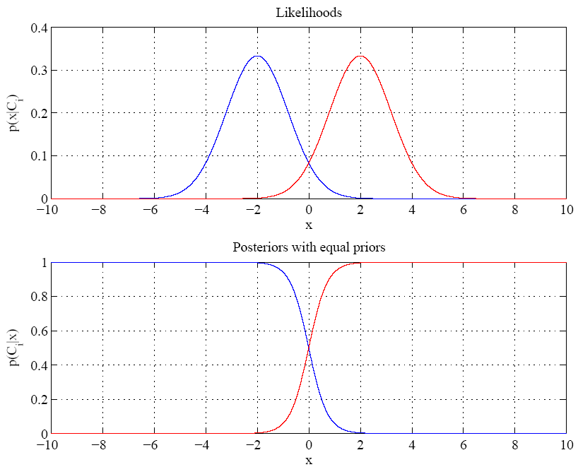
Equal variances
Single boundary at
halfway between means

Slide 17
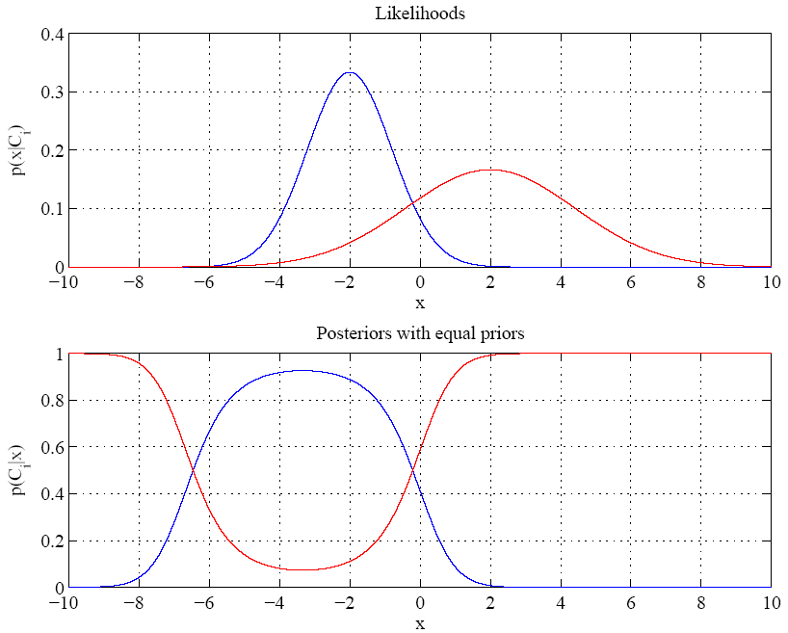
Variances are different
Two boundaries

Slide 18
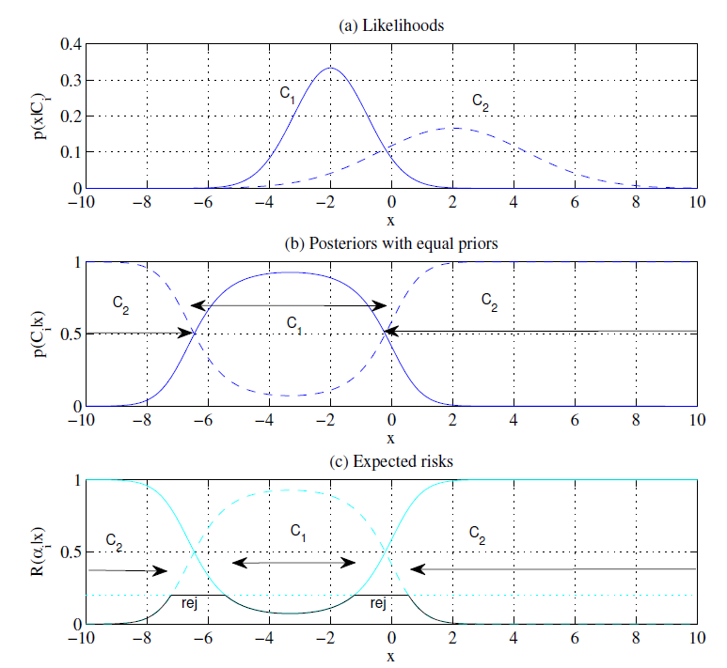

Slide 19
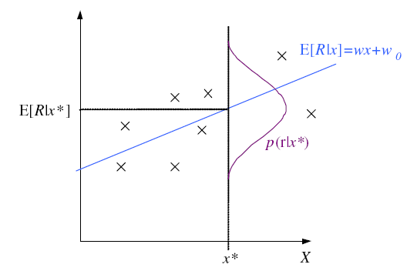
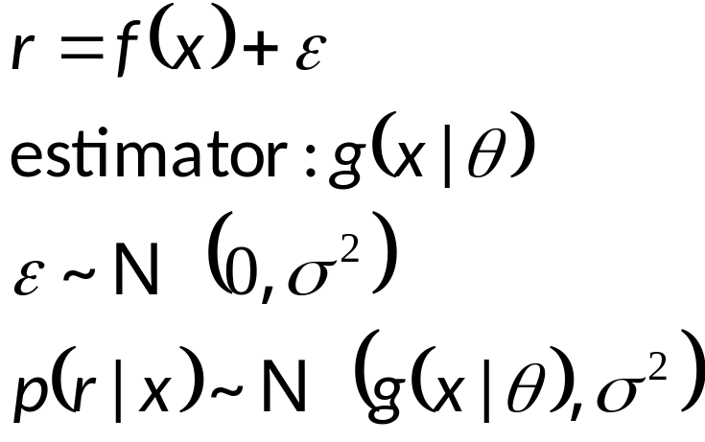
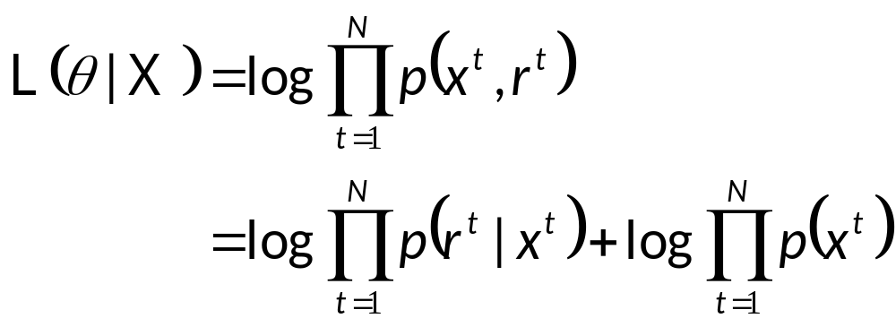
Regression

Slide 20
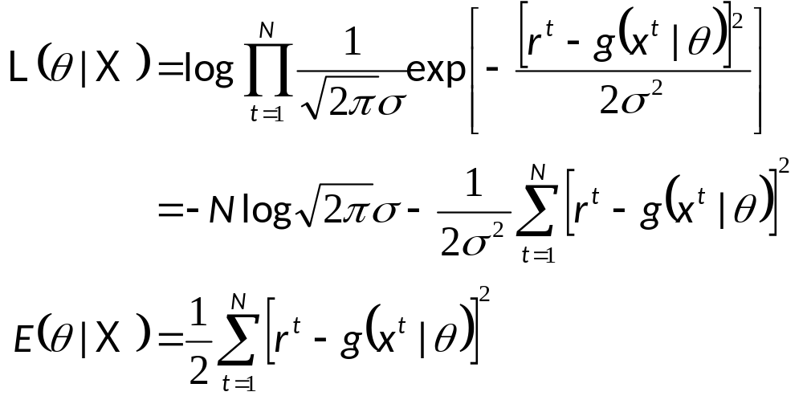
Regression: From LogL to Error

Slide 21
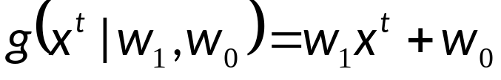
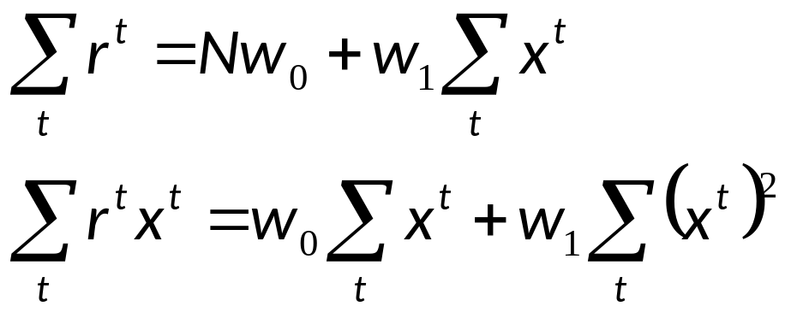
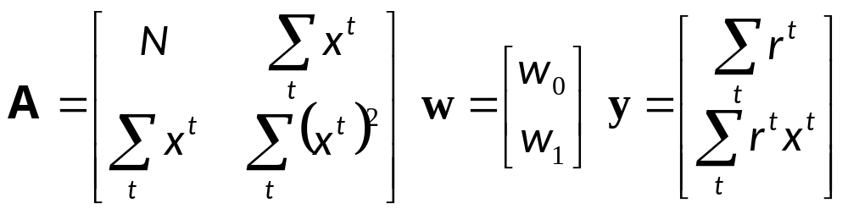
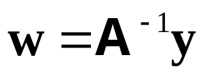
Linear Regression

Slide 22
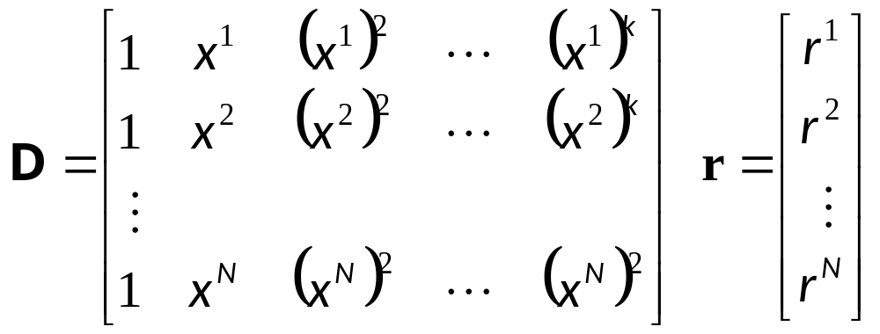
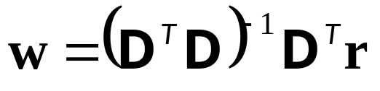
Polynomial Regression

Slide 23
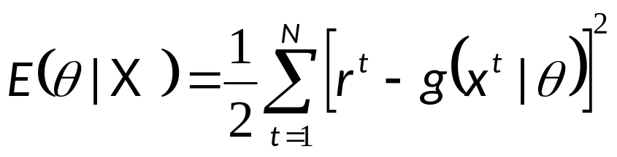
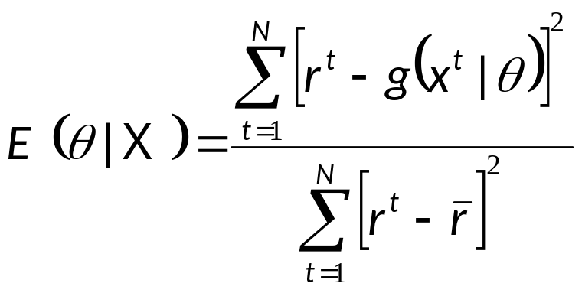
Other Error Measures
Square Error:
Relative Square Error:
Absolute Error: E (θ |X) = _{∑t} |r^{t} – g(x^{t}| θ)|
ε-sensitive Error:
  E (θ |X) = _{∑ t} 1(|r^{t} – g(x^{t}| θ)|>ε) (|r^{t} – g(x^{t}|θ)| – ε)

Slide 24
Bias and Variance
noise
squared error
bias
variance

Slide 25
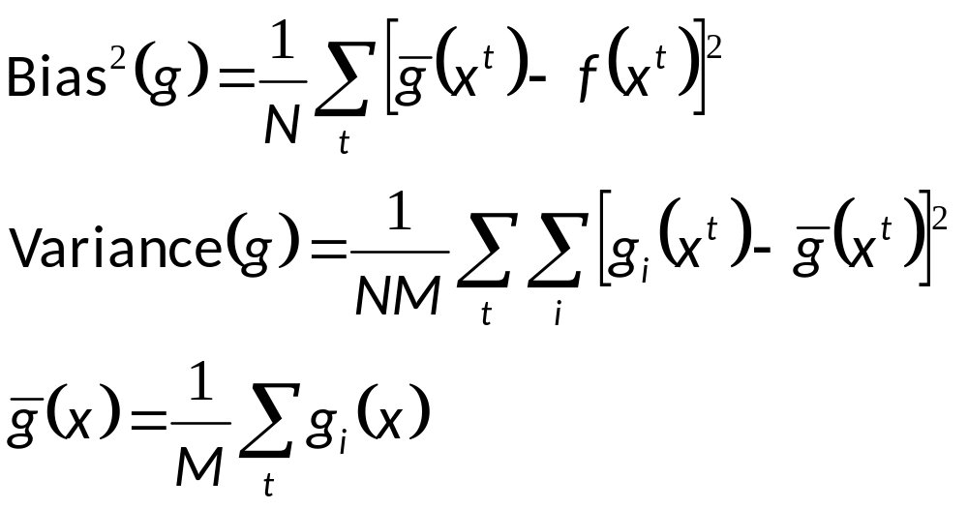
Estimating Bias and Variance
M samples X_{i}={x^{t}_{i} , r^{t}_{i}}, i=1,...,M
are used to fit g_{i} (x), i =1,...,N

Slide 26
Bias/Variance Dilemma
Example: g_{i}(x)=2 has no variance and high bias
g_{i}(x)= _{∑t} r^{t}_{i}/N has lower bias with variance
As we increase complexity,
bias decreases (a better fit to data) and
variance increases (fit varies more with data)
Bias/Variance dilemma: (Geman et al., 1992)

Slide 27
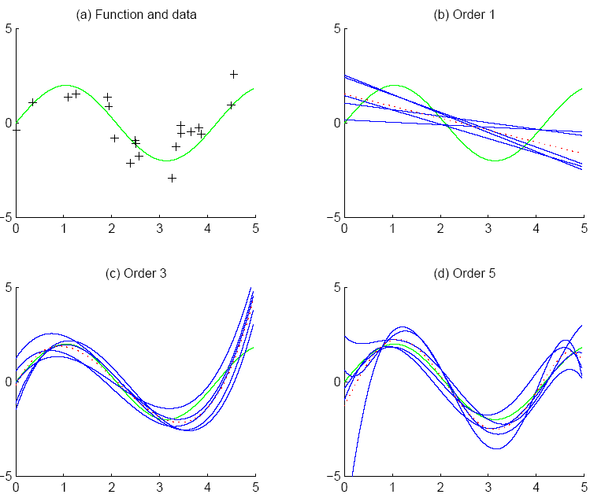
f
f
bias
g_{i}
g
variance

Slide 28
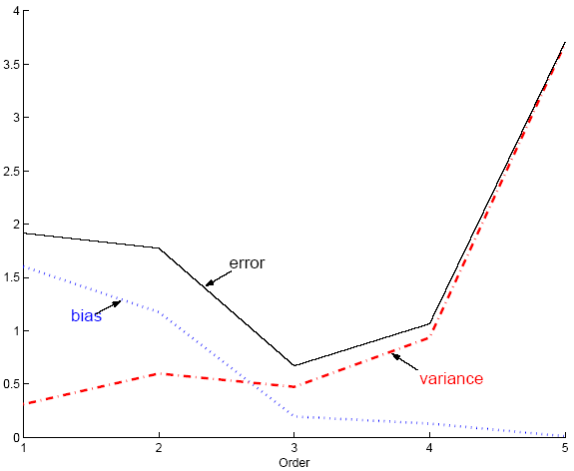
Polynomial Regression
Best fit “min error”

Slide 29
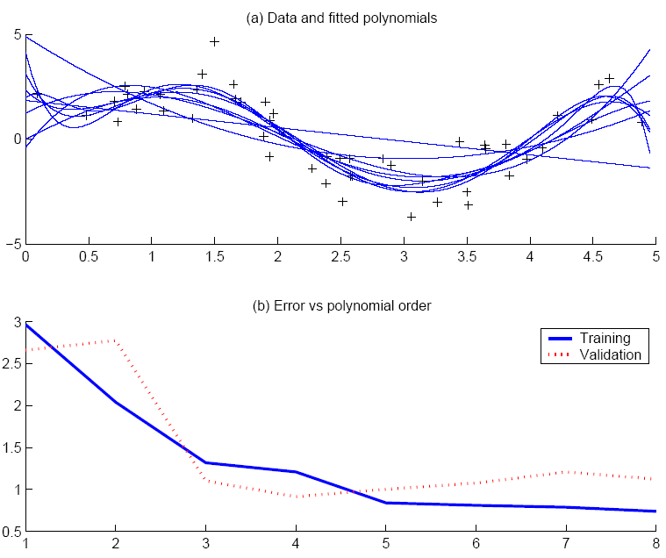
Best fit, “elbow”

Slide 30
Model Selection
Cross-validation: Measure generalization accuracy by testing on data unused during training
Regularization: Penalize complex models
E’=error on data + λ model complexity
Akaike’s information criterion (AIC), Bayesian information criterion (BIC)
Minimum description length (MDL): Kolmogorov complexity, shortest description of data
Structural risk minimization (SRM)

Slide 31
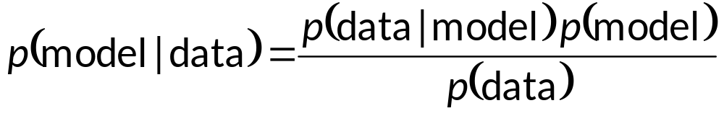
Bayesian Model Selection
Prior on models, p(model)
Regularization, when prior favors simpler models
Bayes, MAP of the posterior, p(model|data)
Average over a number of models with high posterior (voting, ensembles: Chapter 17)

Slide 32
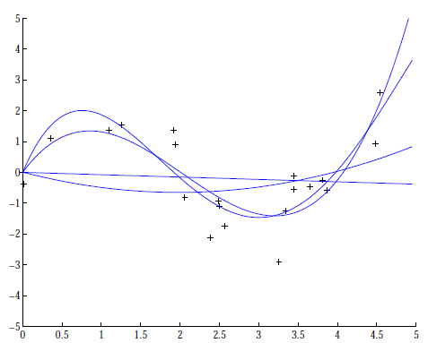
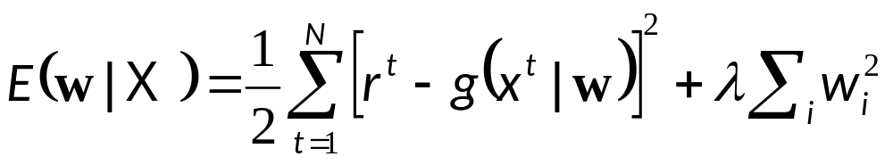
Regression example
Coefficients increase in magnitude as order increases:
1: [-0.0769, 0.0016]
2: [0.1682, -0.6657, 0.0080]
3: [0.4238, -2.5778, 3.4675, -0.0002
4: [-0.1093, 1.4356,
-5.5007, 6.0454, -0.0019]
Regularization (L2):

Slide 33
CHAPTER 5:
Multivariate Methods

Slide 34
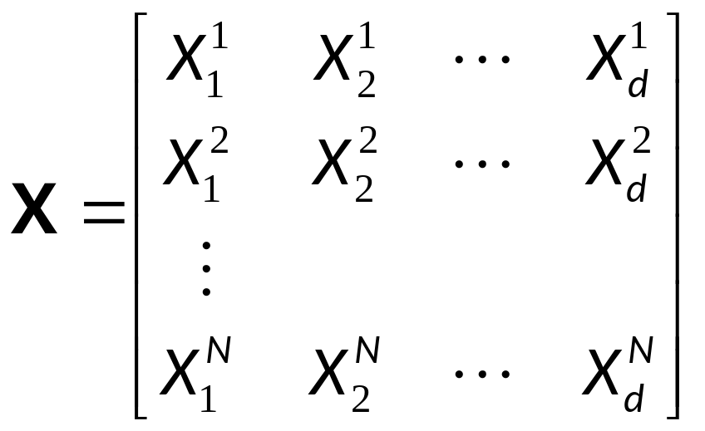
Multivariate Data
Multiple measurements (sensors)
d inputs/features/attributes: d-variate
N instances/observations/examples

Slide 35
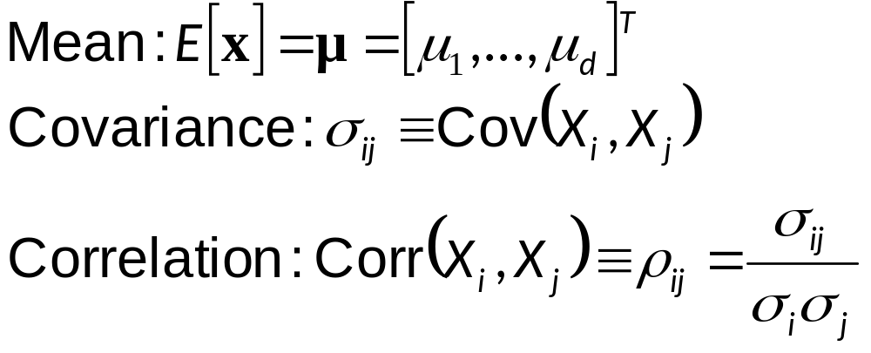
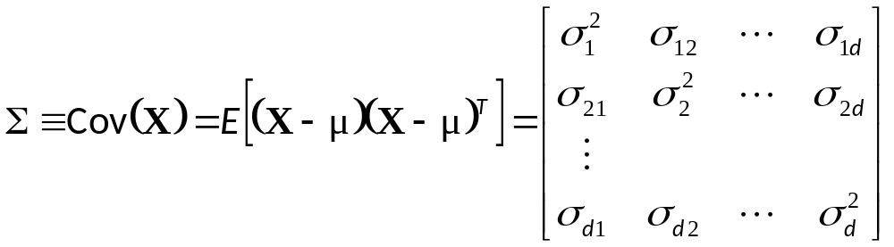
Multivariate Parameters

Slide 36
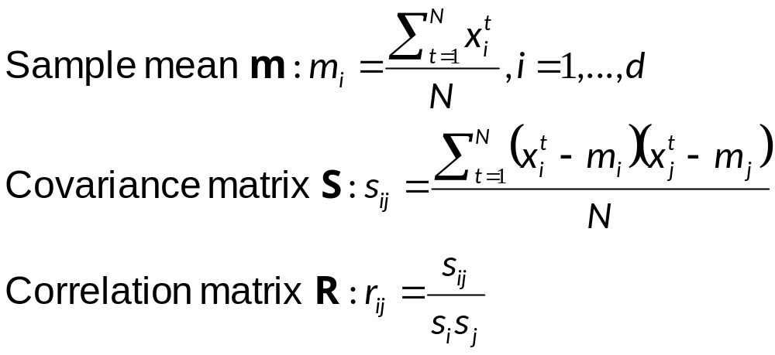
Parameter Estimation

Slide 37
Estimation of Missing Values
What to do if certain instances have missing attributes?
Ignore those instances: not a good idea if the sample is small
Use ‘missing’ as an attribute: may give information
Imputation: Fill in the missing value
  Mean imputation: Use the most likely value (e.g., mean)
  Imputation by regression: Predict based on other attributes

Slide 38


Multivariate Normal Distribution

Slide 39


Multivariate Normal Distribution
Mahalanobis distance: (x – μ)^{T} ∑^{–1} (x – μ)
  measures the distance from x to μ in terms of ∑ (normalizes for difference in variances and correlations)
Bivariate: d = 2

Slide 40

Bivariate Normal

Slide 41


Slide 42

Independent Inputs: Naive Bayes
If x_{i} are independent, offdiagonals of ∑ are 0, Mahalanobis distance reduces to weighted (by 1/σ_{i}) Euclidean distance:
If variances are also equal, reduces to Euclidean distance

Slide 43


Parametric Classification
If p (x | C_{i} ) ~ N ( μ_{i} , ∑_{i} )
Discriminant functions

Slide 44


Estimation of Parameters

Slide 45




Discrete Features
Binary features:
if x_{j} are independent (Naive Bayes’)
the discriminant is linear
Estimated parameters

Slide 46


Discrete Features
Multinomial (1-of-n_{j}) features: x_{j} Î {v₁, v₂,..., v_{nj}}
if x_{j} are independent

Slide 47
Acknowledgements
http://www.cmpe.boun.edu.tr/~ethem/i2ml3e
https://users.cs.fiu.edu/~taoli/class/CAP4770-F10/class08.ppt

